Slide 1
Playing Tetris with
Deep Reinforcement Learning
Wenhui Ma
ECE 556 / 08. 01. 2025.
Notes:
Good morning everyone.
My project is about using reinforcement learning to play the game of Tetris.

Slide 2
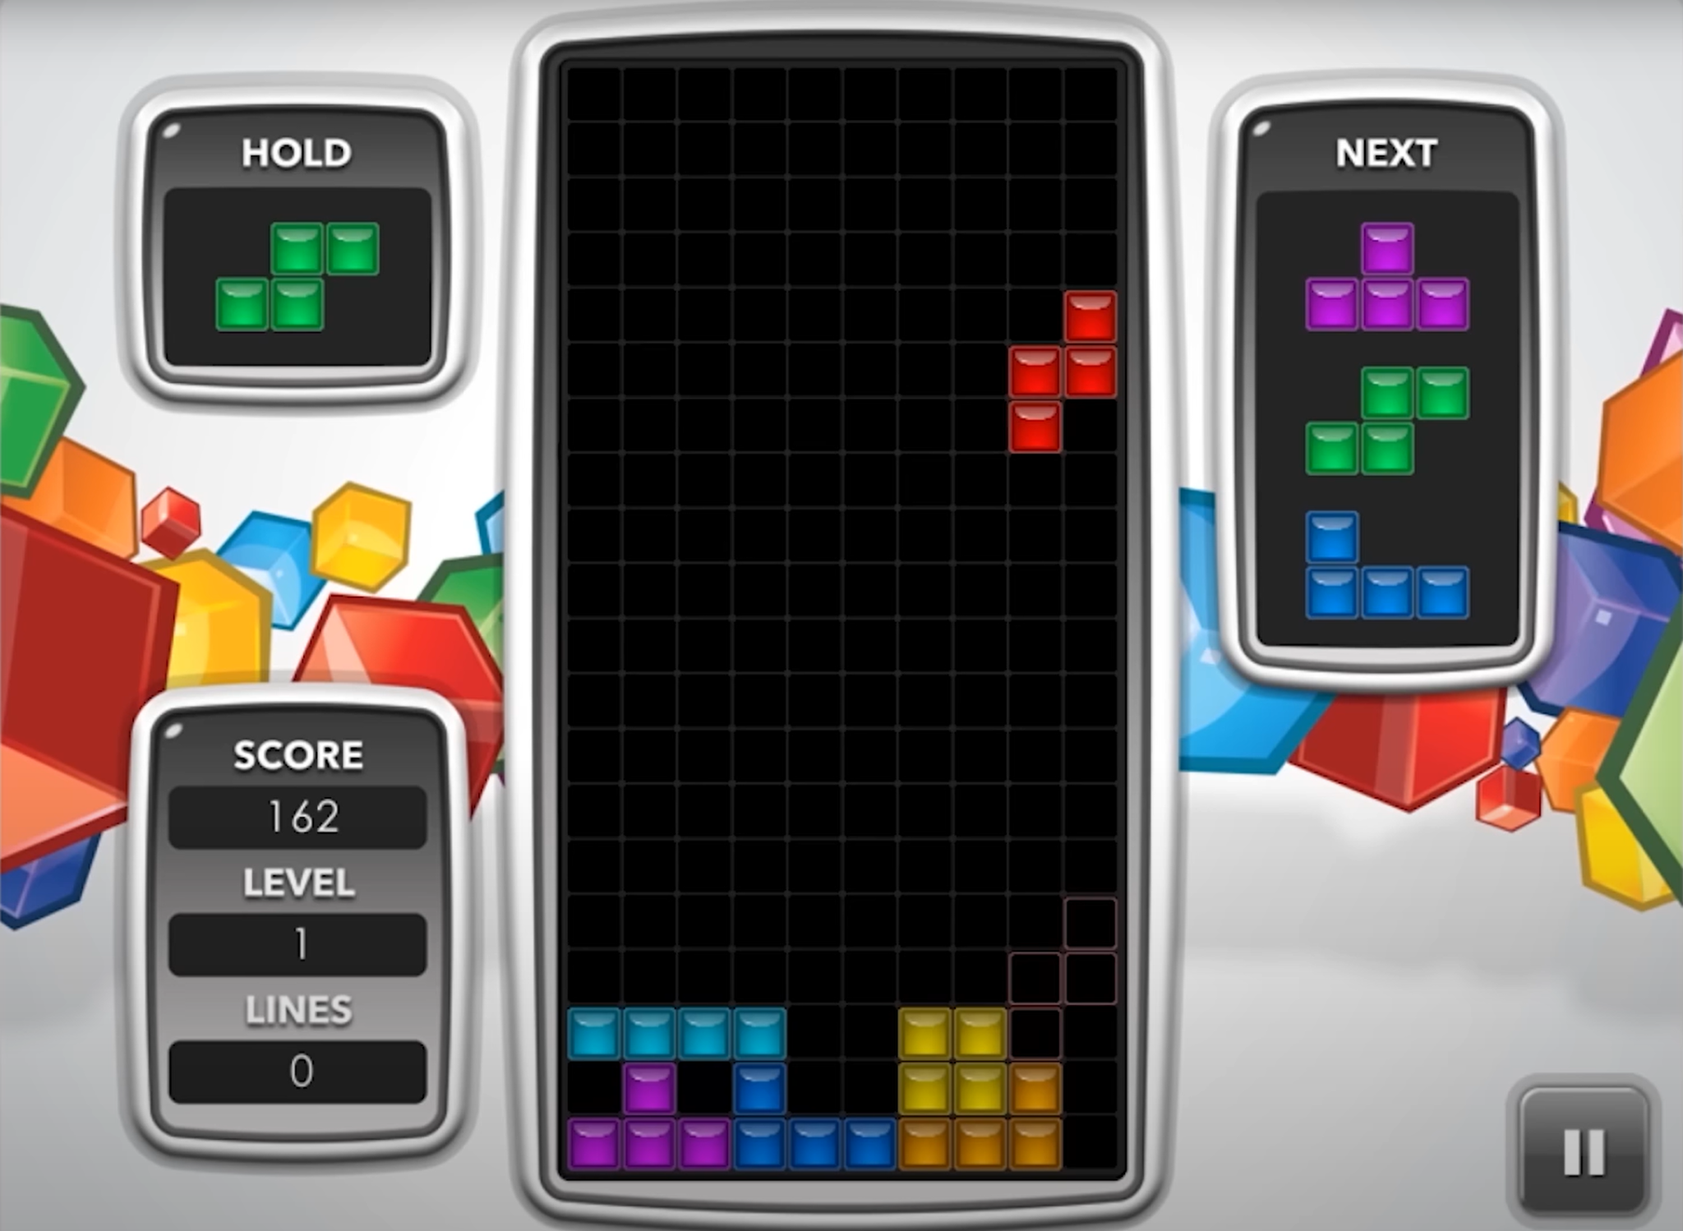
Introduction
🎮 Basic Game Rules
A piece (tetromino) falls one at a time from the top.
Player can rotate and move the piece before it drops.
If a row is fully filled, it disappears and the player scores.
Game ends when blocks reach the top of the board.
🧱 7 Tetromino types:
I, O, T, S, Z, J, L
🟪 Board size: 10 columns × 20 rows
Notes:
You probably know Tetris — a block-dropping game where you rotate and position pieces to clear rows and avoid stacking too high.

Slide 3
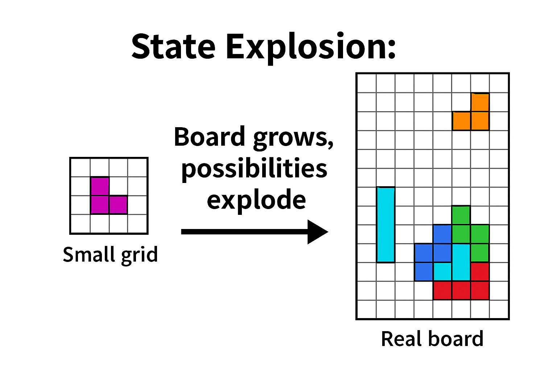
Why is Tetris so Hard?
2²⁰⁰ ≈ 10⁶⁰
The state space (all board configurations × falling pieces × positions) grows exponentially.
There is no known efficient algorithm to solve Tetris optimally in all cases.
Even with perfect future information, planning the best sequence is computationally intractable.
“Even if the entire sequence of upcoming pieces is known, determining whether a player can survive forever is NP-complete.”
— Demaine et al., 2002
✅ Easy to play,
❌ Hard to solve optimally,
❗A perfect environment to study sequential decision-making and reinforcement learning.
Notes:
It seems simple, but from an algorithmic point of view, it’s actually quite hard.
The key challenge is that Tetris has an enormous decision space. At every step, you have a random piece, multiple rotations, many possible placements — and once you make a move, the board changes permanently. In fact, even if you know the entire future sequence of pieces, it’s been proven that deciding how to survive forever is NP-complete. So it’s a tough sequential decision-making problem, and reinforcement learning offers one way to tackle it.
But due to its large state space and delayed rewards, even simple versions of the game can be hard for standard RL algorithms to master.

Slide 4
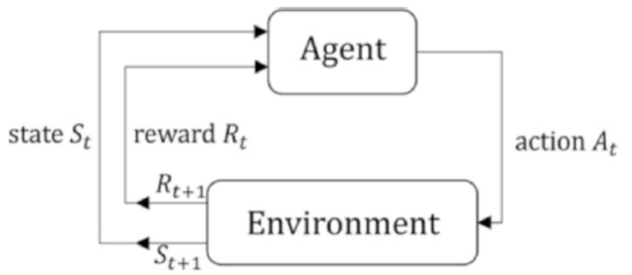
Agent and Environment
Agent : The decision making player, human or AI
At each step, it selects an action: → Move left/right → Rotate → Drop the piece
The goal: maximize score by clearing as many lines as possible and delaying game over.
Environment : The game engine, which:
Displays the current board and falling piece
Applies gravity and performs collision detection
Clears any filled rows
Generates the next tetromino (random or pre-defined)
Returns reward and new state after action
Agent observes the current board and falling piece
Agent receives new state and reward
Agent takes an action (e.g., rotate and place)
Environment updates the board, clears lines, and spawns next piece
Notes:
Now let’s frame it as a Markov Decision Process.
The agent — which could be a human or an AI — observes the current board and the falling piece. It chooses an action, like rotating and placing the block in a certain column.
The environment then updates the board, clears any lines, spawns the next piece, and gives the agent a reward — typically, the number of lines cleared.

Slide 5
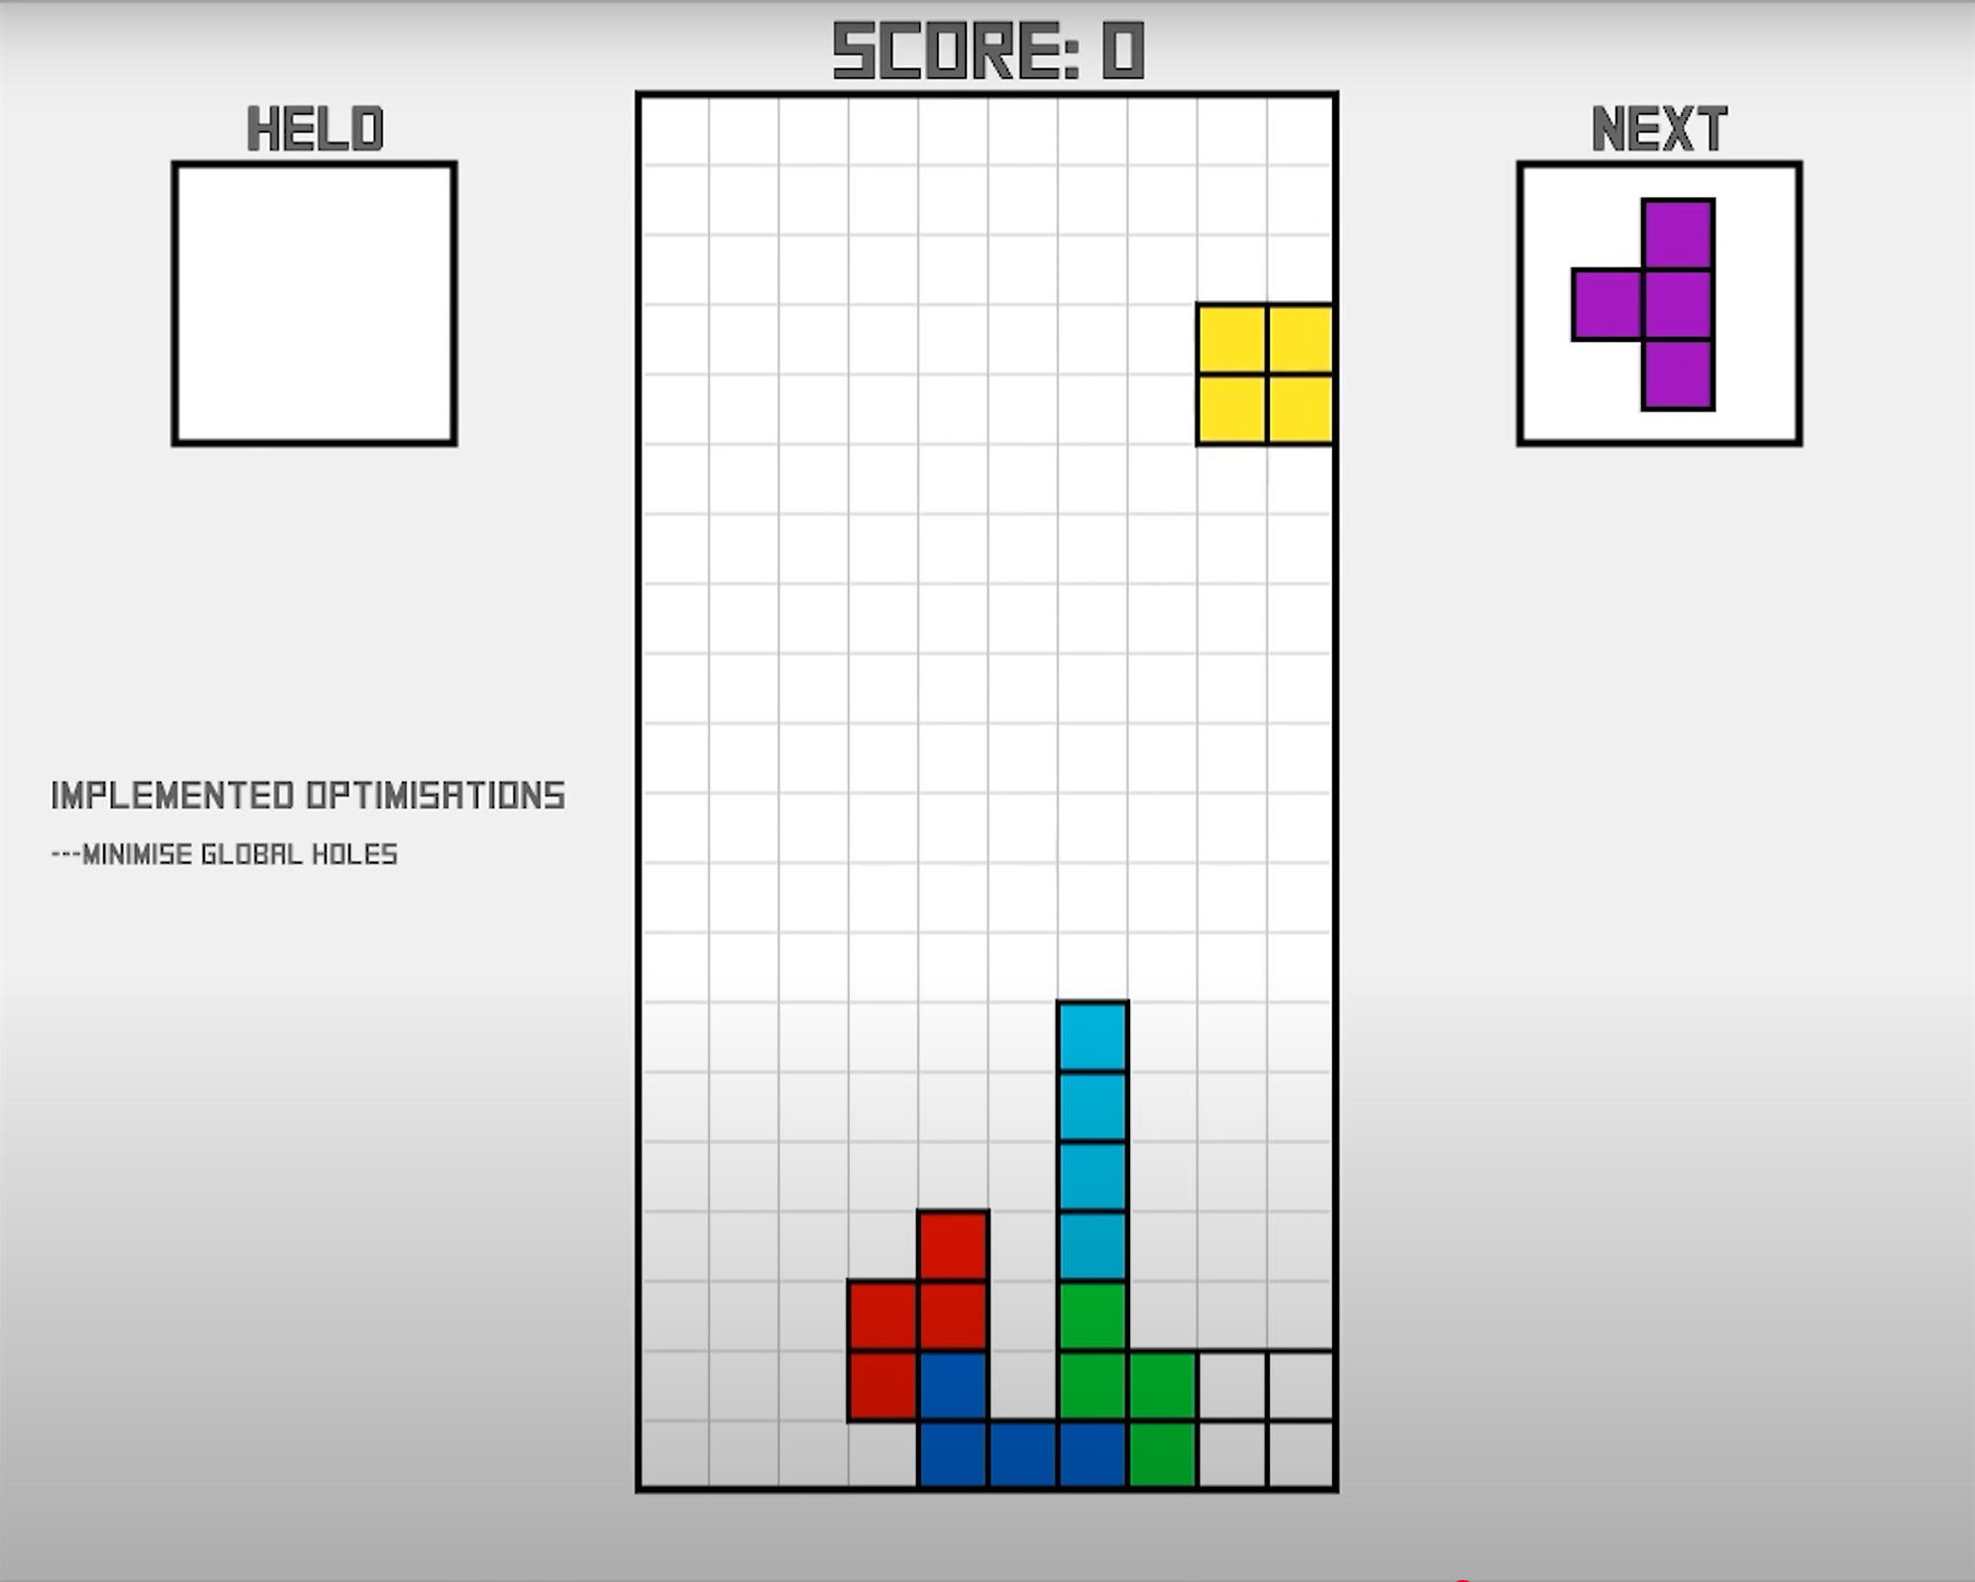
State Space - Part 1
Feature 1 - 6
Lines Cleared
Holes
Bumpiness
Total Height
Max Height
Min Height
Hole
column_heights = [0, 0, 0, 3, 4, 1, 7, 2, 0, 0]
bumpiness = |0−0| + |0−0| + |3−0| + |4−3| + |1−4| + |7−1| + |2−7| + |0−2| + |0−0| = 0+0+3+1+3+6+5+2+0 = 20
Notes:
To help the agent understand the game, we don’t use raw pixels or a full grid.
Instead, we define a 20-dimensional feature vector to represent each state.
This includes things like how many lines were cleared in the last move, how many holes exist in the board, how bumpy the surface is, and the total, max, and min heights of the columns.

Slide 6
State Space - Part 2
Feature 7 - 8
Current Piece Type
Next Piece Type
Current
current_piece = [0,1,0,0,0,0,0] (O)
next_piece = [0,0,1,0,0,0,0] (T)
Total State Vector Length: 6 continuous values + 7 + 7 = 20 dimensions
Notes:
t also includes the current and next piece, encoded as one-hot vectors — that’s important so the model knows what shape it's handling, and what’s coming next.

Slide 7
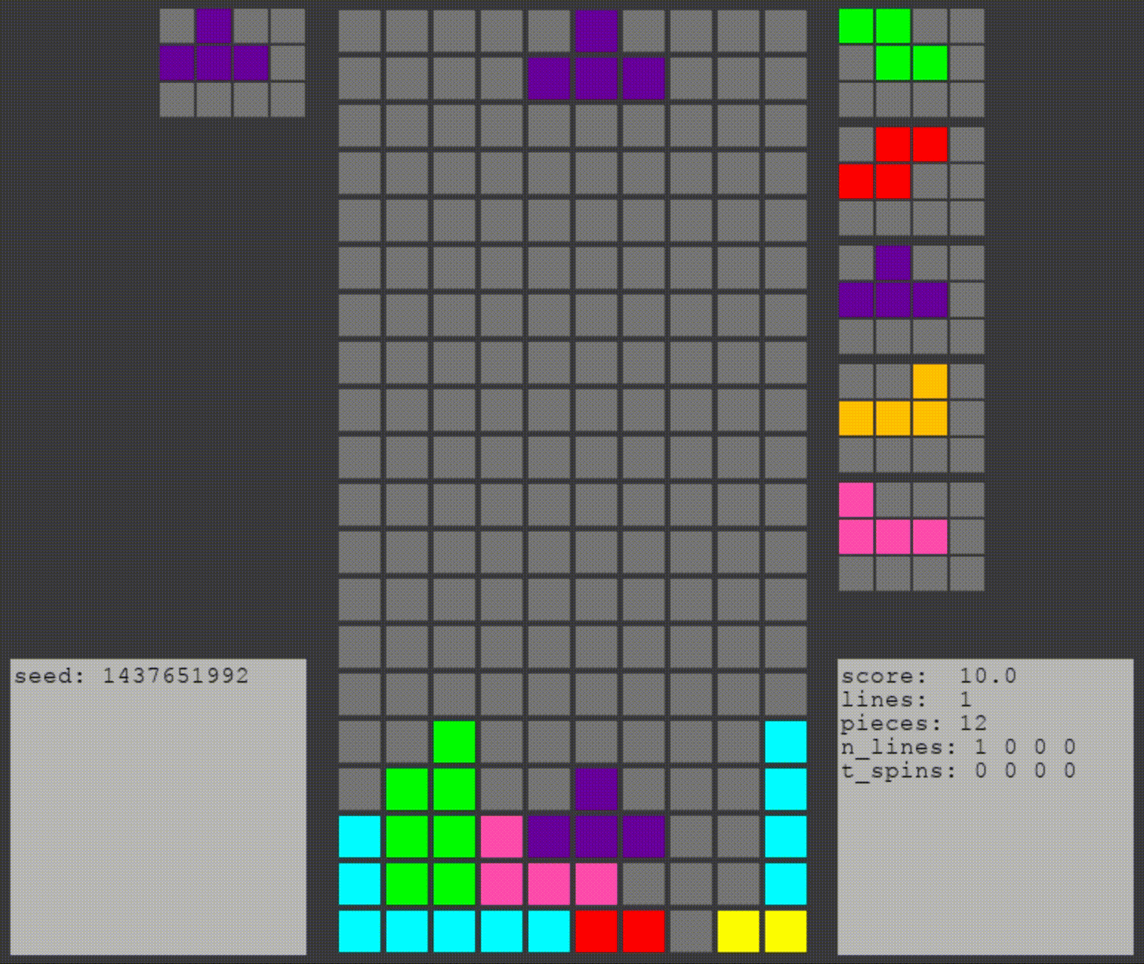
action space
For each falling piece, enumerate
all possible legal placements:
All valid rotations (e.g. 4 orientations for T‑piece)
All column positions it can drop into without collision
Each placement constitutes one action candidate.
Example: Action enumeration for a T piece
Suppose the current piece is a T-block. Possible orientations: 0°, 90°, 180°, 270°.
On a flat board, each orientation can be dropped into, say, 8 valid columns.
That gives up to 4 × 8 = 32 action candidates.
Action space =
dynamic set via enumeration + filtering
Notes:
The action space isn’t fixed — it depends on the current piece.
Each tetromino has several possible rotations and many possible drop columns.
So for example, a T-block might have 4 orientations, and 8 valid columns — giving us around 28 different actions just for that one piece.
Each action is a combination of rotation and position.

Slide 8

Reward
Event | Reward | Purpose
Clearing 1 line | +1 | Positive feedback for efficient stacking
Clearing multiple lines | +n | Proportional reward
Game over (stack overflow) | −10 (or episode ends) | Punishment for bad planning
Other actions | 0 | Neutral feedback if no lines cleared
Simplified reward design: Focused on lines cleared.
Notes:
The reward function we use is quite simple: +1 for each line cleared, 0 if no lines are cleared, and a large negative penalty when the game ends. This encourages the agent to stack efficiently and avoid risky moves.

Slide 9
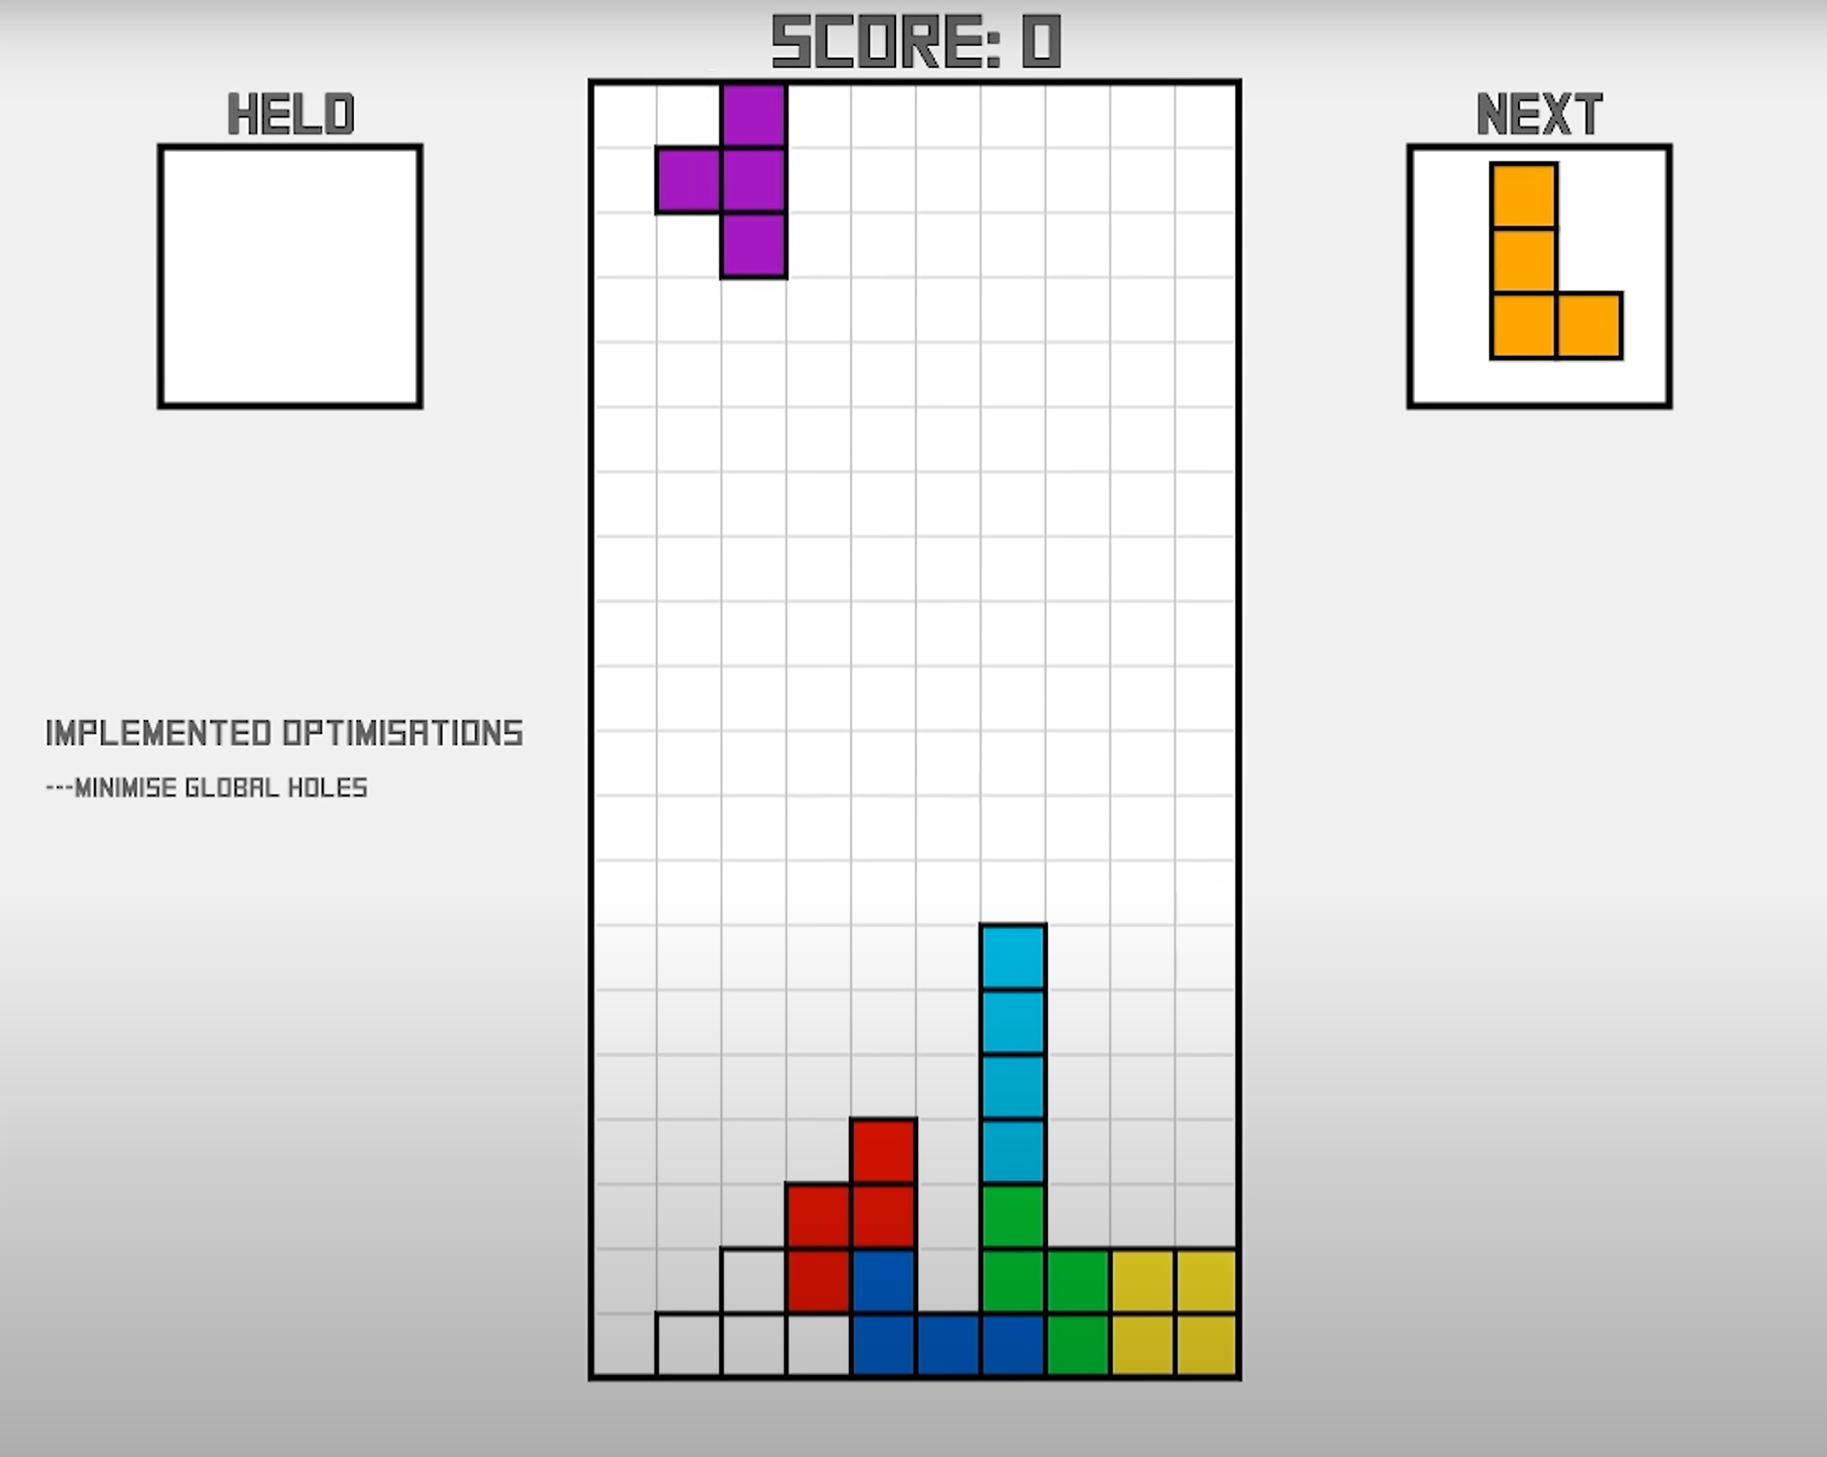
Transition Dynamics
[
0, # lines_cleared
1, # holes
20, # bumpiness
17, # total_height
7, # max_height
0, # min_height
[0,1,0,0,0,0,0], # current_piece (O)
[0,0,1,0,0,0,0] # next_piece (T)
]
S_t
Action a_t =
(rotation=0°, column=9)
[
0, # lines_cleared
1, # holes
18, # bumpiness
21, # total_height
7, # max_height
0, # min_height
[0,0,1,0,0,0,0], # current_piece (T)
[0,0,0,0,0,0,1] # next_piece (L)
]
S_t+1
Reward r_t = 0
Notes:
Transitions between states are mostly deterministic — once the piece is placed, we know exactly how the board will look. The only source of randomness is which piece comes next.

Slide 10
Summary - The 4 Elements of the Tetris MDP
Element | Description
State | Summary features of current board + current/next piece
Action | All legal placements (position × orientation) of the current piece
Reward | Immediate score: lines cleared
Transition | Place piece → board updates → new piece spawns
Notes:
So, putting this together, we get a clean MDP setup:
Well-defined states, actions, rewards, and transitions.

Slide 11
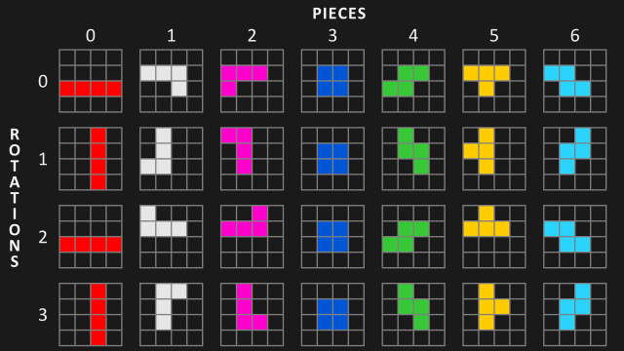
Problem Characteristics of Tetris as an MDP
Property | Classification
Episodic or Continuing | Episodic
State Space | Large, Discrete
Action Space | Dynamic, Discrete
Transition Dynamics | Deterministic (mostly)
Observability | Fully Observable
Markov Property | Satisfies
Notes:
The environment is fully observable and episodic — the game ends when the stack reaches the top.

Slide 12

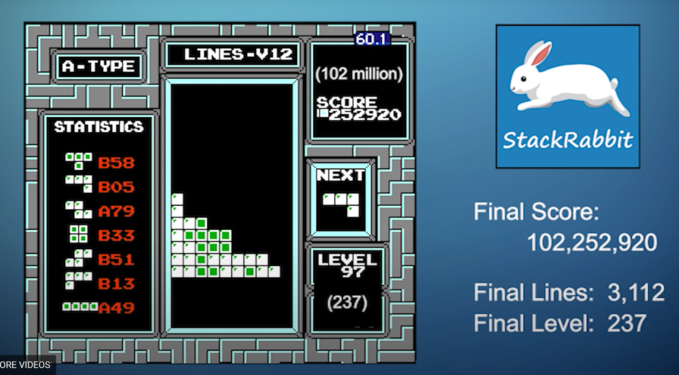
Current Performance
Human Experts vs AI Players
Entity | Platform / Setup | Score / Level Achieved | Notes
Alex T (Human) | Classic Tetris (NES) | 10M+ score; Level 235+ | First human >10M; CTWC 2× champion (2025)
StackRabbit (AI) | Standard NES gameplay | 102M score; Level 237+ | No hardware/controller constraints (2021)
Alex Thach
Built by: Greg Cannon
Notes:
Before I wrap up, I want to share something I found inspiring.
Thank you.

Slide 13
Thanks !
Notes:
Thank you for listening and I am looking forward to questions.

